Slide 1
Stateless programming model
Ehsan saeedi - 97723272
Spring -2019

Slide 2
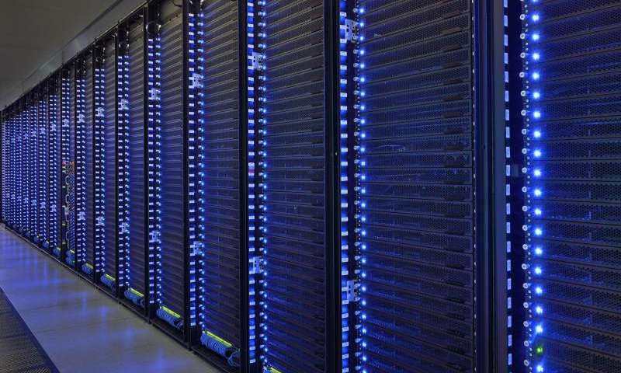
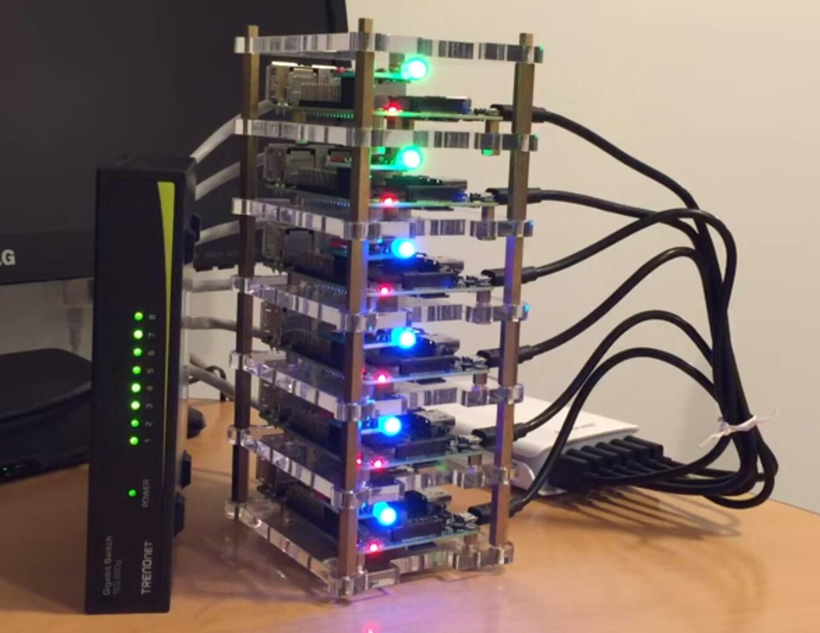
Notes:
*a way to handle parallel processing and scaling in a high performance network — an environment that was not available before.
*Today, hardware and infrastructure capabilities have caught up with and exceeded
Many common practices and accepted programming models do not address important challenges inherent in designing systems for modern computer architectures
To be successful, distributed systems must cope in an environment where components crash without responding, messages get lost without a trace on the wire, and network latency fluctuates.

Slide 3
Stateful vs. Stateless
Applications in Stateful react by the current state
BUT
Stateless applications act independently with taking into consideration previous/next request.
Notes:
If the web server stores data in a backend manner and uses it to identify the user as an always-connected client, the service is Stateful. While in Stateless, the server does store data, but in a database to verify user/client whenever it needs to connect.
In Stateful, the server thinks a client is just a dumb machine, while in Stateless, server things client is an intelligent machine which doesn’t need to depend on any state on the server side.
In Stateless, requests are self-contained, i.e. everything contained within the request, and handled in two distinct phases, a “request” and “response.” While in Stateful, request always dependent on the server-side state.

Slide 4
Serverless architecture
BaaS (Backend as a Service)
FaaS(Function as a Service)
Actor model
Notes:
State full is not appropriate for modern system…blah blah Consequently, organizations building distributed systems with demanding requirements encounter challenges that cannot fully be solved with a traditional model(object-oriented programming (OOP) ) …
Function in stateless actor is like function and is stateless stateless let us to scale app easily

Slide 5
What is Serverless?
Application designs that incorporate third-party services “Backend as a Service” (BaaS)
For example, you might use Auth0 for your authentication, SendGrid for your email, Stripe for payment processing, SQL AZURE or Firebase for your data, and so on.
Custom code run in managed, ephemeral containers on a “Functions as a Service” (FaaS) platform
Deploy our code in the smallest units possible - at the function level.
Notes:
serverless is a style of architecting applications where you avoid using traditional backend servers, such as virtual machines running web servers, databases or background tasks.
Serverless was first used to describe applications that significantly or fully incorporate third-party, cloud-hosted applications and services, to manage server-side logic and state. These are typically “rich client” applications—think single-page web apps, or mobile apps—that use the vast ecosystem of cloud-accessible databases (e.g., Parse, Firebase), authentication services (e.g., Auth0, AWS Cognito), and so on. These types of services have been previously described as “(Mobile) Backend as a Service", and I use "BaaS" as shorthand in the rest of this article.
Serverless can also mean applications where server-side logic is still written by the application developer, but, unlike traditional architectures, it’s run in stateless compute containers that are event-triggered, ephemeral (may only last for one invocation), and fully managed by a third party.
One way to think of this is “Functions as a Service” or "FaaS". (Note: The original source for this name—a tweet by @marak—is no longer publicly available.) AWS Lambda is one of the most popular implementations of a Functions-as-a-Service platform at present, but there are many others, too.

Slide 6
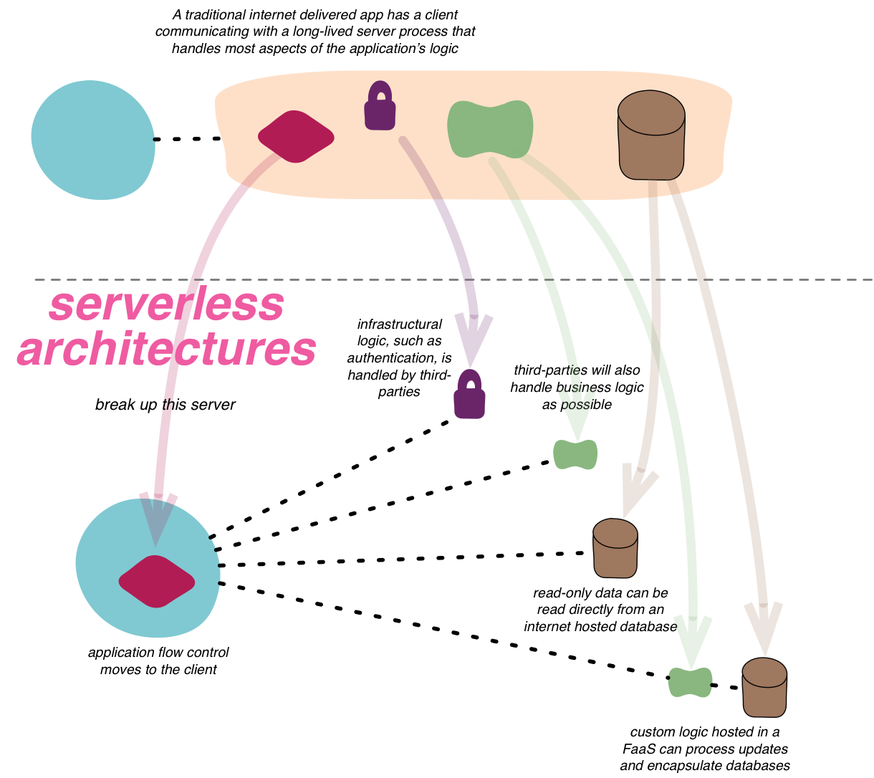
What is Serverless?
Notes:
serverless is a style of architecting applications where you avoid using traditional backend servers, such as virtual machines running web servers, databases or background tasks.
Serverless was first used to describe applications that significantly or fully incorporate third-party, cloud-hosted applications and services, to manage server-side logic and state. These are typically “rich client” applications—think single-page web apps, or mobile apps—that use the vast ecosystem of cloud-accessible databases (e.g., Parse, Firebase), authentication services (e.g., Auth0, AWS Cognito), and so on. These types of services have been previously described as “(Mobile) Backend as a Service", and I use "BaaS" as shorthand in the rest of this article.
Serverless can also mean applications where server-side logic is still written by the application developer, but, unlike traditional architectures, it’s run in stateless compute containers that are event-triggered, ephemeral (may only last for one invocation), and fully managed by a third party.
One way to think of this is “Functions as a Service” or "FaaS". (Note: The original source for this name—a tweet by @marak—is no longer publicly available.) AWS Lambda is one of the most popular implementations of a Functions-as-a-Service platform at present, but there are many others, too.

Slide 7
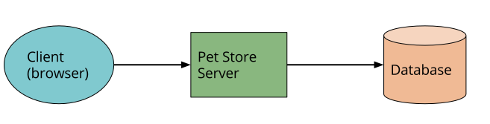
Traditional architecture
Notes:
With this architecture the client can be relatively unintelligent, with much of the logic in the system—authentication, page navigation, searching, transactions—implemented by the server application.
With a Serverless architecture this may end up looking more like this:
is a massively simplified view, but even here we see a number of significant changes:
1-We’ve deleted the authentication logic in the original application and have replaced it with a third-party BaaS service (e.g., Auth0.)
2-Using another example of BaaS, we’ve allowed the client direct access to a subset of our database (for product listings), which itself is fully hosted by a third party (e.g., Google Firebase.) We likely have a different security profile for the client accessing the database in this way than for server resources that access the database.
3-some logic that was in the Pet Store server is now within the client
4-compute intensive or requires access to significant amounts of data. implement a FaaS function that responds to HTTP requests via an API gateway (described later)
5- we may replace our “purchase” functionality with another separate FaaS function

Slide 8
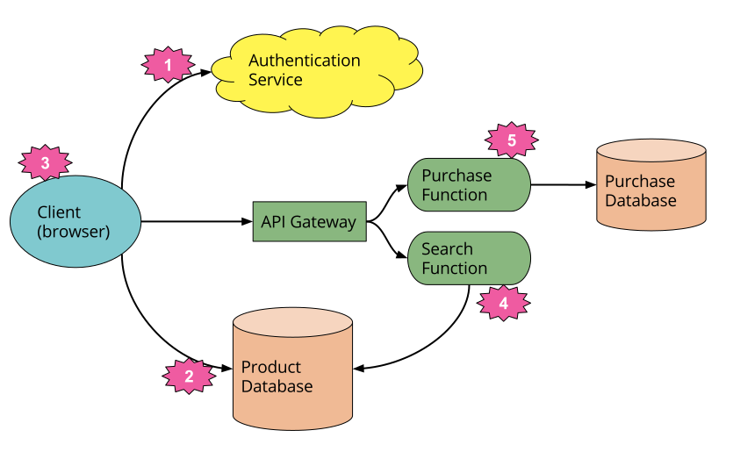
Serverless architecture
Notes:
With this architecture the client can be relatively unintelligent, with much of the logic in the system—authentication, page navigation, searching, transactions—implemented by the server application.
With a Serverless architecture this may end up looking more like this:
is a massively simplified view, but even here we see a number of significant changes:
1-We’ve deleted the authentication logic in the original application and have replaced it with a third-party BaaS service (e.g., Auth0.)
2-Using another example of BaaS, we’ve allowed the client direct access to a subset of our database (for product listings), which itself is fully hosted by a third party (e.g., Google Firebase.) We likely have a different security profile for the client accessing the database in this way than for server resources that access the database.
3-some logic that was in the Pet Store server is now within the client
4-compute intensive or requires access to significant amounts of data. implement a FaaS function that responds to HTTP requests via an API gateway (described later)
5- we may replace our “purchase” functionality with another separate FaaS function

Slide 9
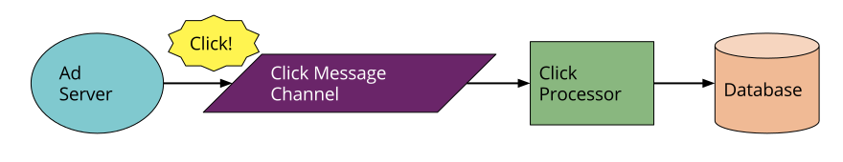
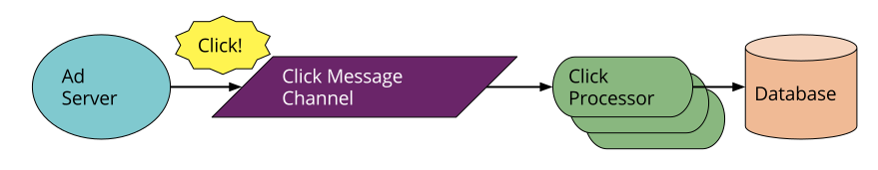
Message-driven applications
Notes:
Think about an online advertisement system: when a user clicks on an ad you want to very quickly redirect them to the target of that ad. At the same time, you need to collect the fact that the click has happened so that you can charge the advertiser. (This example is not hypothetical—my former team at Intent Media had exactly this need, which they implemented in a Serverless way.)
Traditionally, the architecture may look as below. The “Ad Server” synchronously responds to the user (not shown) and also posts a “click message” to a channel. This message is then asynchronously processed by a “click processor” application that updates a database, e.g., to decrement the advertiser’s budget.
We’ve replaced a long-lived message-consumer application with a FaaS function. This function runs within the event-driven context the vendor provides. Note that the cloud platform vendor supplies both the message broker and the FaaS environment—the two systems are closely tied to each other.
The FaaS environment may also process several messages in parallel by instantiating multiple copies of the function code. Depending on how we wrote the original process this may be a new concept we need to consider.

Slide 10
FaaS
Running backend code without managing your own server systems or your own long-lived server applications
Each function has an “event” that it is waiting for to trigger it
just write the bit of code that responds to the event you are interested in and you don't need to know or care about what server your function is hosted on, or even how many servers there are
The fact that the server is abstracted away means your functions need to be stateless, since you don't know which server will handle the next event.
Notes:
Deployment is very different
FaaS functions have significant architectural restrictions though, especially when it comes to state and execution duration.
Horizontal scaling is completely automatic, elastic, and managed by the provider.
FaaS provider creating and destroying them purely driven by runtime need. Most importantly, with FaaS the vendor handles all underlying resource provisioning and allocation
also allow functions to be triggered as a response to inbound HTTP requests; in AWS one typically enables this by way of using an API gateway.

Slide 11
State and Execution duration
No guarantee that such state is persisted across multiple invocations(function is stateless)
More strongly, you should not assume that state from one invocation of a function will be available to another invocation of the same function.
Typically limited in how long each invocation is allowed to run
Notes:
FaaS functions have significant restrictions when it comes to local (machine/instance-bound) state—i.e., data that you store in variables in memory, or data that you write to local disk.
FaaS functions are therefore often described as stateless, but it’s more accurate to say that any state of a FaaS function that is required to be persistent needs to be externalized outside of the FaaS function instance. Such state-oriented functions will typically make use of a database, a cross-application cache (like Redis), or network file/object store (like S3) to store state across requests, or to provide further input necessary to handle a request.
This means that certain classes of long-lived tasks are not suited to FaaS functions without re-architecture—you may need to create several different coordinated FaaS functions, whereas in a traditional environment you may have one long-duration task performing both coordination and execution.
Startup latency and “cold starts” talks
Pros and cons less cost in development and deploy .. Less scaling costs
Reduced packaging and deployment complexity
Vendor lock-in
Security concerns
Repetition of logic across client platforms
DoS yourself
Startup latency
Execution duration (more than 5 mins)

Slide 12
Actor model

Slide 13

Akka (Áhkká)
The name comes from the goddess in the Sami
(native swedes) mythology that represented all
the wisdom and beauty in the world.
It is also the name of a mountain in
Laponia in the north part of Sweden

Slide 14
Akka (Áhkká)

Slide 15
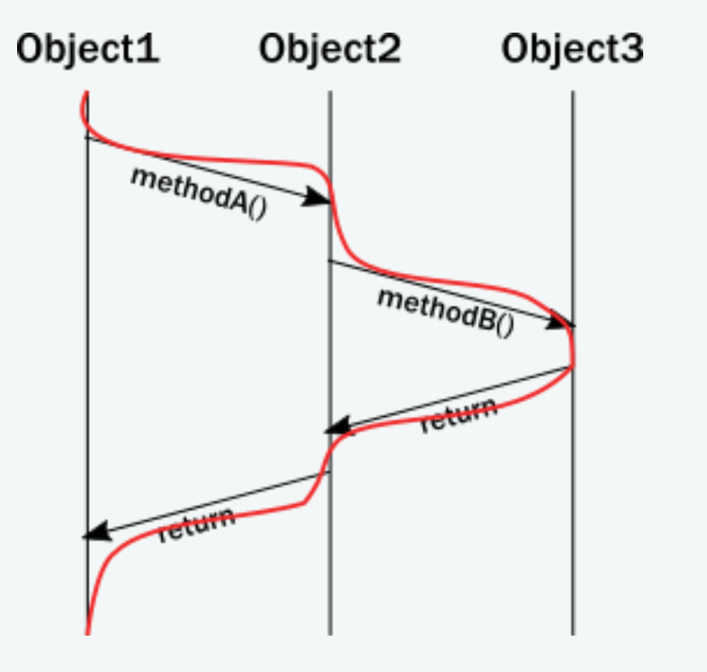
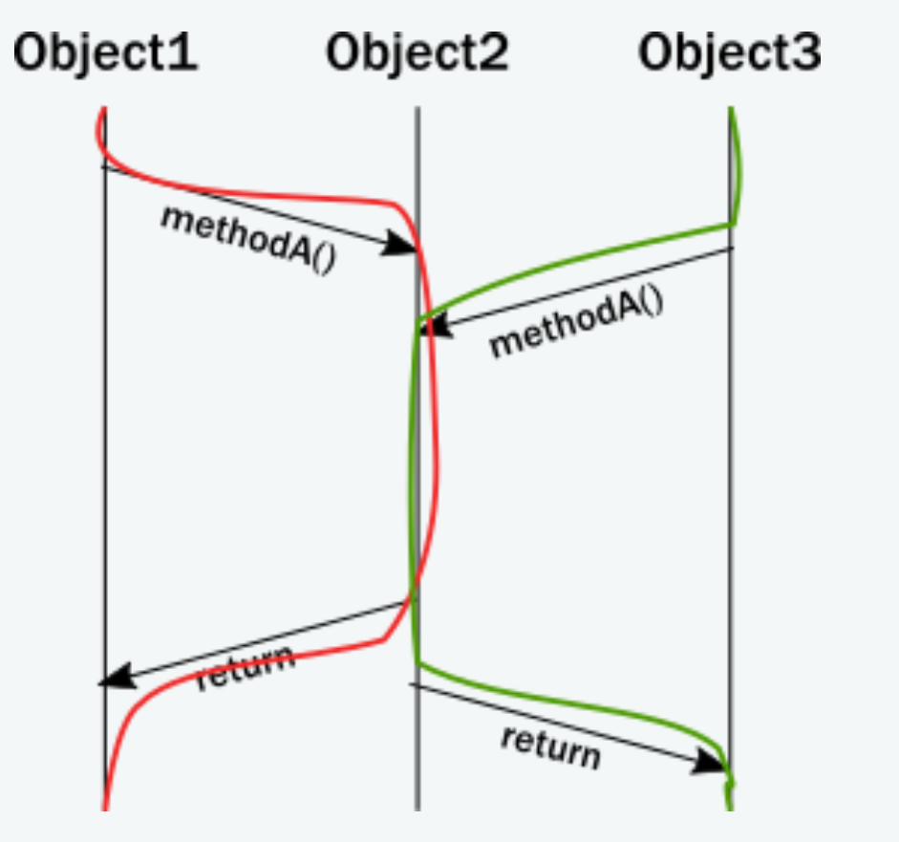
The challenge of encapsulation
OOP runtime behavior
Notes:
In reality, a thread executes all these calls, and the enforcement of invariants occurs on the same thread from which the method was called. Updating the diagram with the thread of execution, it looks like this:
There is a section of execution where two threads enter the same method. Unfortunately, the encapsulation model of objects does not guarantee anything about what happens in that section
approach to solving this problem is to add a lock around these method are very costly on modern CPU architectures, requiring heavy-lifting from the operating system to suspend the thread and restore it later.
Additionally, locks only really work well locally. When it comes to coordinating across multiple machines, the only alternative is distributed locks.
The illusion of a call stack – error propagation in threads
to achieve any meaningful concurrency and performance on current systems, threads must delegate tasks among each other in an efficient way without blocking. With this style of task-delegating concurrency (and even more so with networked/distributed computing) call stack-based error handling breaks down and new, explicit error signaling mechanisms need to be introduced. Failures become part of the domain model.
Concurrent systems with work delegation needs to handle service faults and have principled means to recover from them. Clients of such services need to be aware that tasks/messages might get lost during restarts. Even if loss does not happen, a response might be delayed arbitrarily due to previously enqueued tasks (a long queue), delays caused by garbage collection, etc. In face of these, concurrent systems should handle response deadlines in the form of timeouts, just like networked/distributed systems.

Slide 16
The illusion of shared memory
On modern architectures - if we simplify things a bit - CPUs are writing to cache lines instead of writing to memory directly.
Notes:
Most of these caches are local to the CPU core, that is, writes by one core are not visible by another. In order to make local changes visible to another core, and hence to another thread, the cache line needs to be shipped to the other core’s cache.
Instead of hiding the message passing aspect through variables marked as shared or using atomic data structures, a more disciplined and principled approach is to keep state local to a concurrent entity and propagate data or events between concurrent entities explicitly via messages.

Slide 17
Vision
Simpler
Concurrency
Scalability
Fault-tolerance

Slide 18
Scale UP & Scale OUT

Slide 19
Manage System Overload

Slide 20
Programming at a Higher Level
Never think in terms of shared state, state visibility, threads, locks
High CPU utilization, low latency, and scalability
Detecting and recovering from errors
Notes:
Never think in terms of shared state, state visibility, threads, locks.
High CPU utilization, low latency, high throughput and scalability - FOR FREE as part of the model
Detecting and recovering from errors

Slide 21
Distributable by Design
Actors are location transparent & distributable by design
Scale UP and OUT for free as part of the model
You get the PERFECT FABRIC for the CLOUD
elastic & dynamic
fault-tolerant and self-healing
adaptive load-balancing, cluster rebalancing & actor migration
build extremely loosely coupled and dynamic systems (change and adapt at runtime)
Notes:
The AdaptiveLoadBalancingPool / AdaptiveLoadBalancingGroup performs load balancing of messages to cluster nodes based on the cluster metrics data. It uses random selection of routees with probabilities derived from the remaining capacity of the corresponding node.

Slide 22

How?

Slide 23
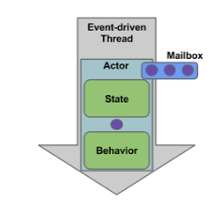
What is an Actor?
Akka's unit of code organization is called an Actor
A container for
State
Behavior
Mailbox
Child Actors
Supervisor Strategy
All of this is encapsulated behind an Actor Reference
Notes:
Actors is a model for organizing your code that keeps many “policy decisions”
Actors is a model for organizing your code that keeps many “policy decisions”
Tried-and-true concept (Hewitt 1973) used for many years in telecom systems with 9 nines uptime
One noteworthy aspect is that actors have an explicit lifecycle, they are not automatically destroyed when no longer referenced; after having created one, it is your responsibility to make sure that it will eventually be terminated as well—which also gives you control over how resources are released When an Actor Terminates.

Slide 24
Actor Reference
Represents an actor
Can be passed around freely and without restriction
Notes:
But the most important aspect is that it is not possible to look inside an actor and get hold of its state from the outside, unless the actor unwisely publishes this information itself.
enables transparency for all the desired operations: restarting an actor without needing to update references elsewhere, placing the actual actor object on remote hosts, sending messages to actors in completely different applications.

Slide 25
State
Actor objects typically contain some variables
What makes an actor valuable
Must be protected from corruption by other actors
Actors objects are stateless
Notes:
This can be an explicit state machine (e.g. using the FSM module), or it could be a counter, set of listeners, pending requests, etc. These data are what make an actor valuable, and they must be protected from corruption by other actors.
Because the internal state is vital to an actor’s operations, having inconsistent state is fatal. Thus, when the actor fails and is restarted by its supervisor, the state will be created from scratch, like upon first creating the actor. This is to enable the ability of self-healing of the system.
Optionally, an actor’s state can be automatically recovered to the state before a restart by persisting received messages and replaying them after restart (see Persistence).

Slide 26
Behavior and Mailbox
behavior is a function which defines the actions to be taken in reaction to the message at that point in time
behavior may change over time
The piece which connects sender and receiver
Notes:
These changes are achieved by either encoding them in state variables which are read from the behavior logic, or the function itself may be swapped out at runtime, see the become and unbecome operations
When an Actor Terminates
Once an actor terminates, i.e. fails in a way which is not handled by a restart, stops itself or is stopped by its supervisor, it will free up its resources, draining all remaining messages from its mailbox into the system’s “dead letter mailbox” which will forward them to the EventStream as DeadLetters. To “guarantee delivery”.

Slide 27
What can I use Actors for?
In different scenarios, an Actor may be an alternative to:
a thread
an object instance or component
a callback or listener
a service
a router, load-balancer or pool
a Finite State Machine (FSM)

Slide 28

Actor Model
Carl Hewitt’s definition

Slide 29
Actor Model
Carl Hewitt’s definition
AKKA
The fundamental unit of computation that embodies:
Processing
Storage
Communication
axioms(When an Actor receives a message):
Create new Actors
Send messages to Actors it knows
Designate how it should handle the next message it receives
Actor operations
CREATE
SEND
BECOME
SUPERVISE

Slide 30
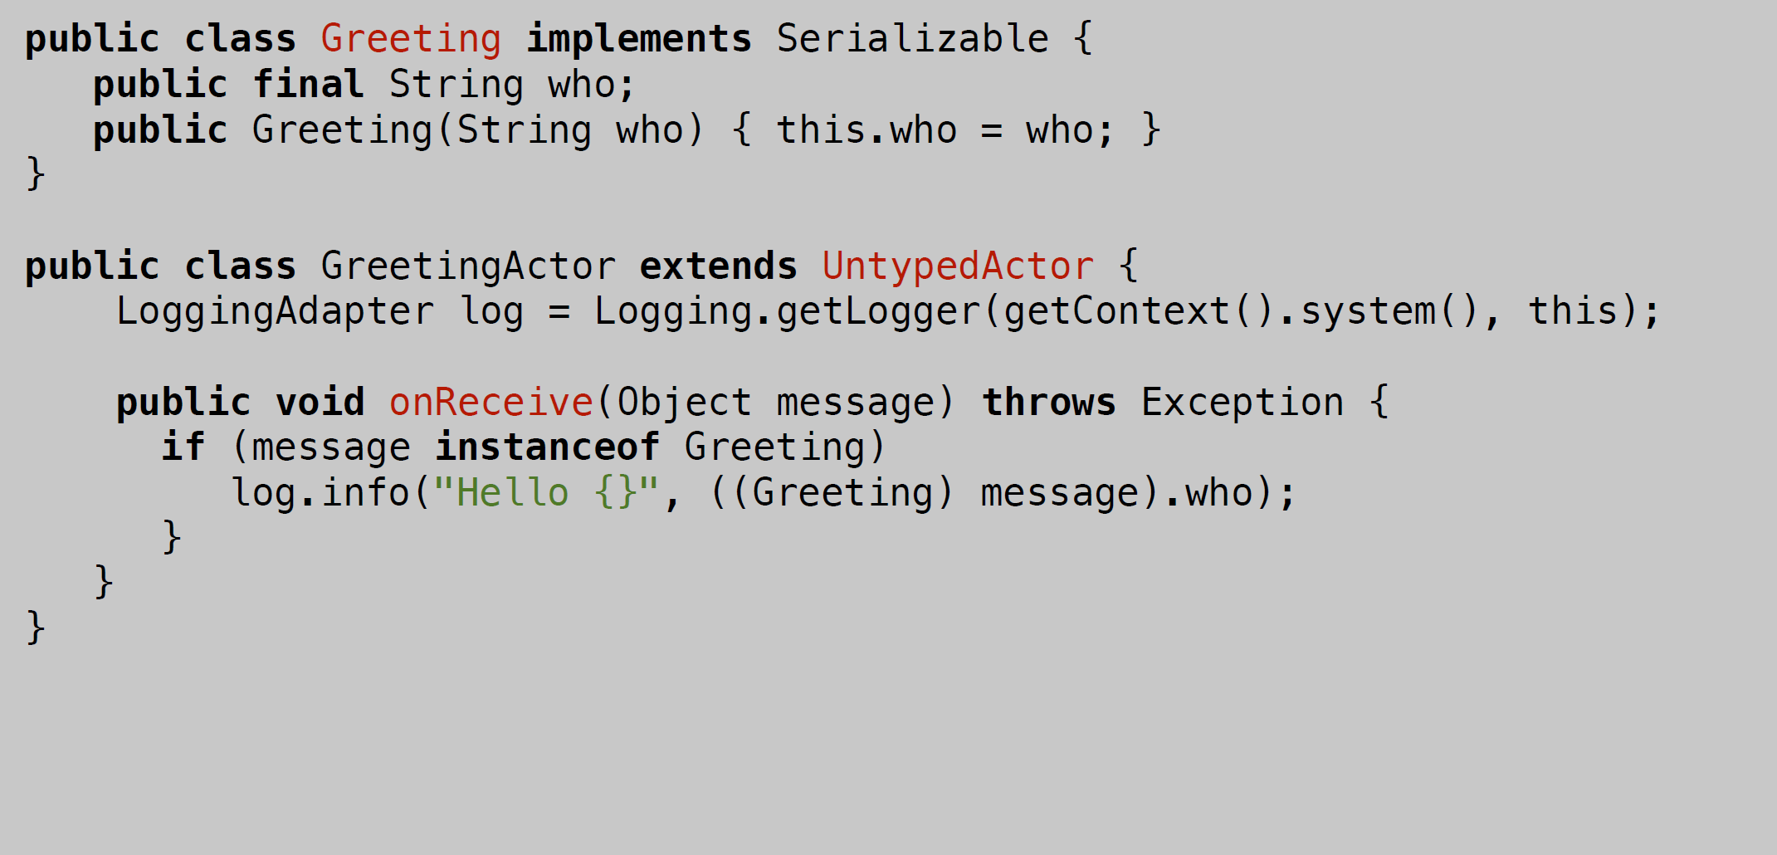
Define an actor
Define the message(s) the Actor
should be able to respond to
Define the Actor class
Define the Actor’s behavior

Slide 31
CREATE
Extremely lightweight (2.7 Million per Gb RAM)
Strong encapsulation
State & behavior is indistinguishable from each other (will be discussed in next slides)
Only way to observe state is by sending an actor a message
Notes:
Very strong encapsulation - encapsulates:
- state
- behavior
- message queue

Slide 32
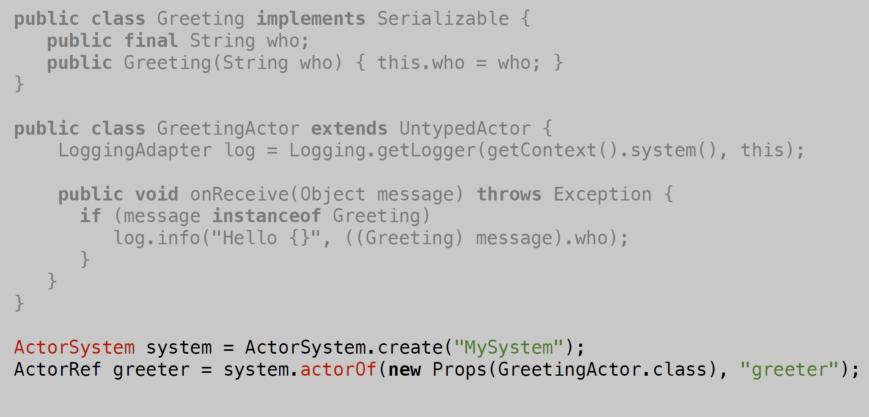
Create an Actor system
Create an Actor system
Create an Actor system
Get an ActorRef back
Create an Actor system

Slide 33
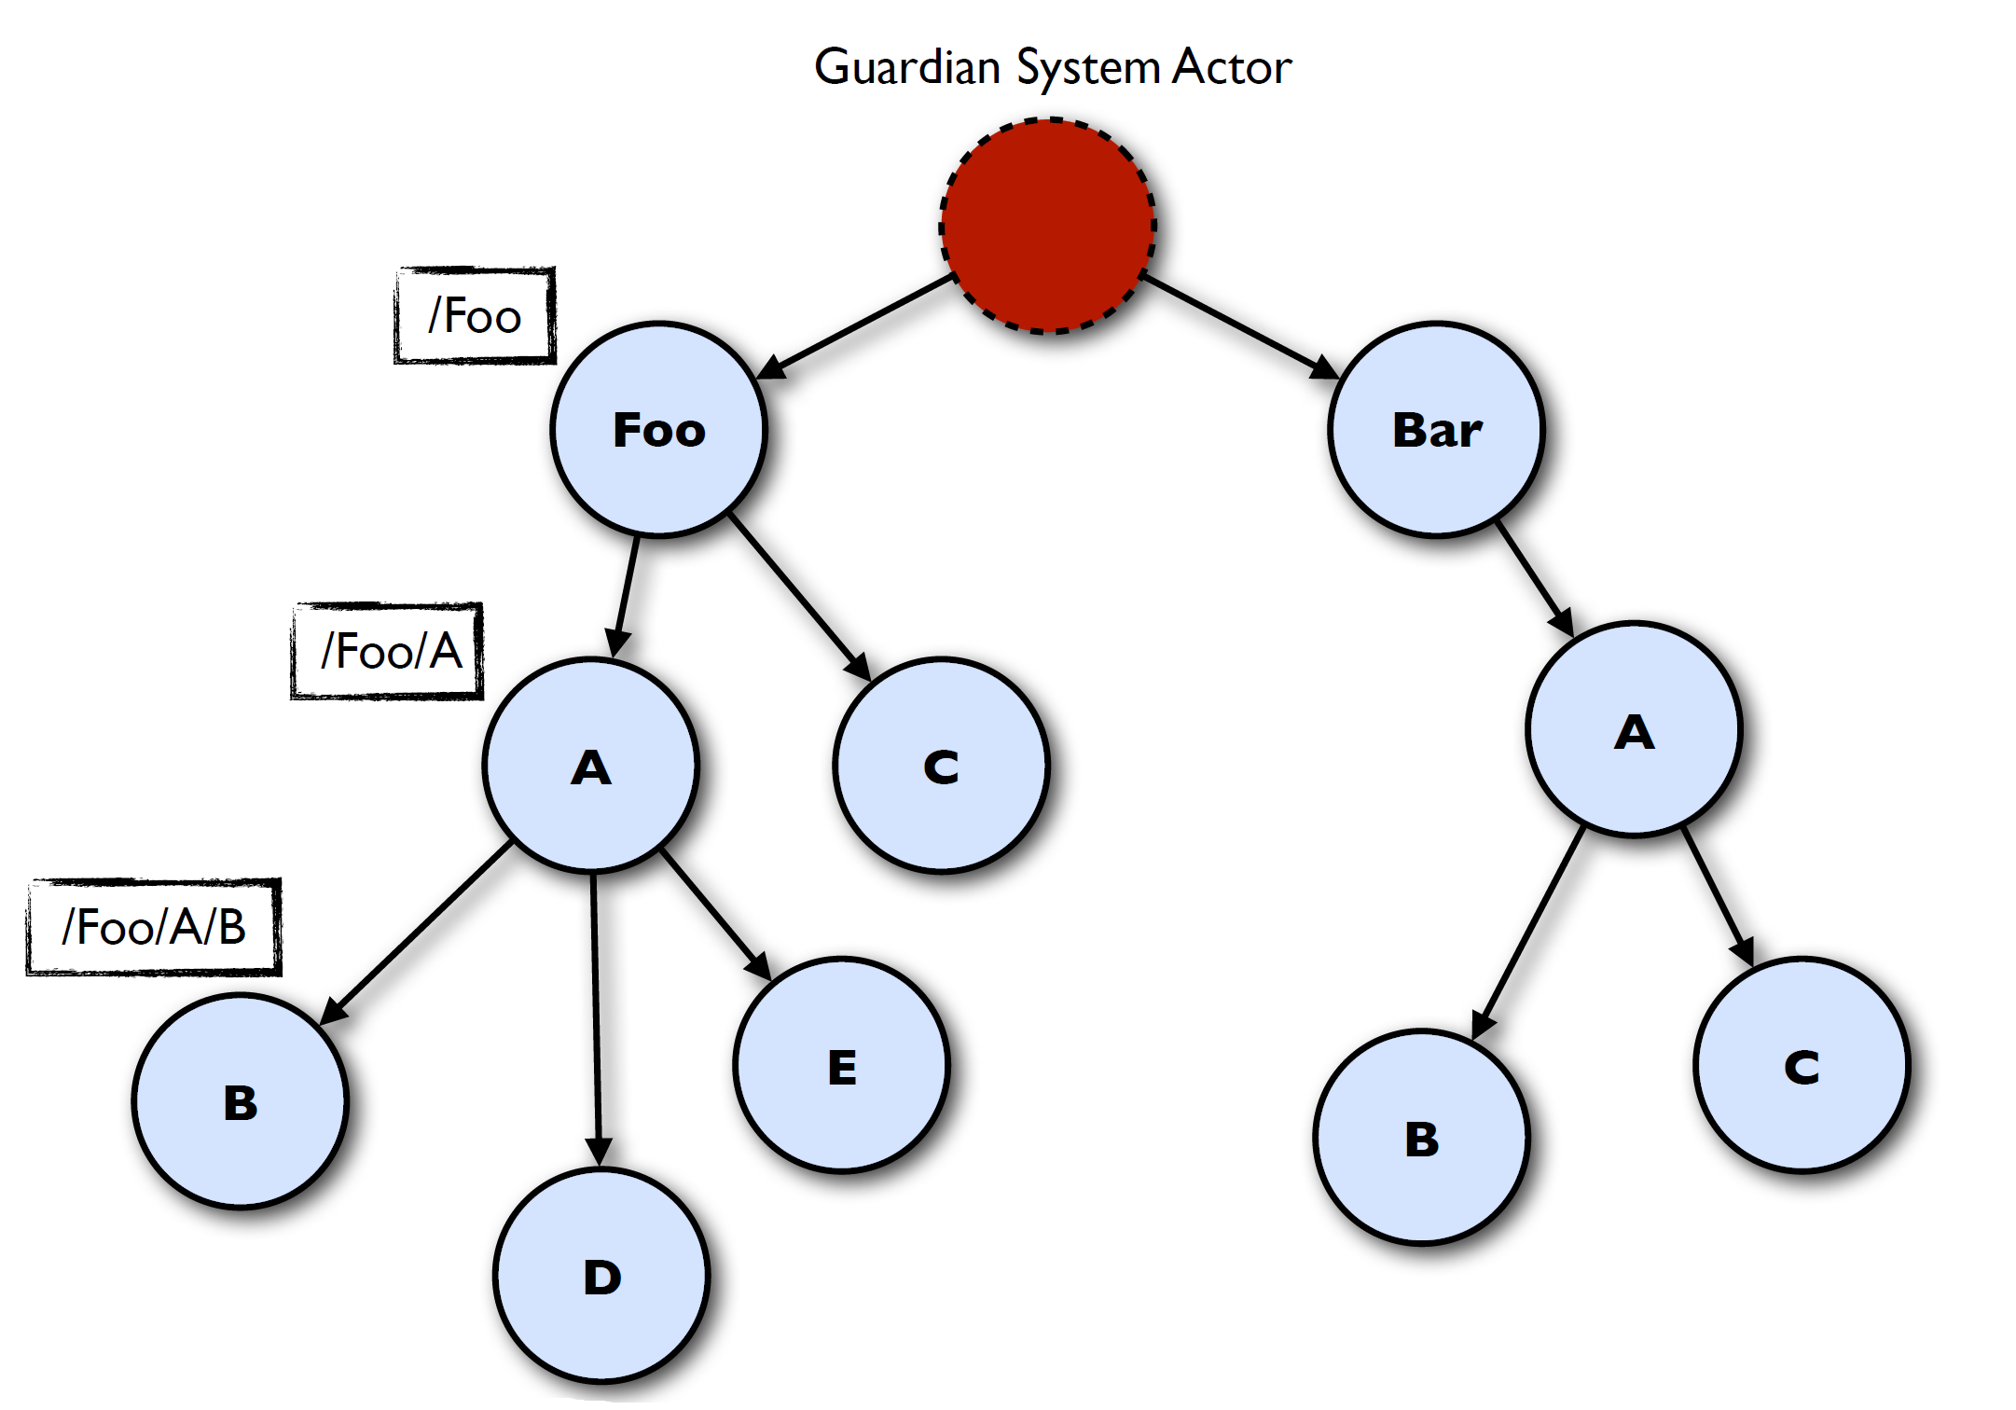
Actors form hierarchies
Notes:
Name resolution - like a file-system

Slide 34
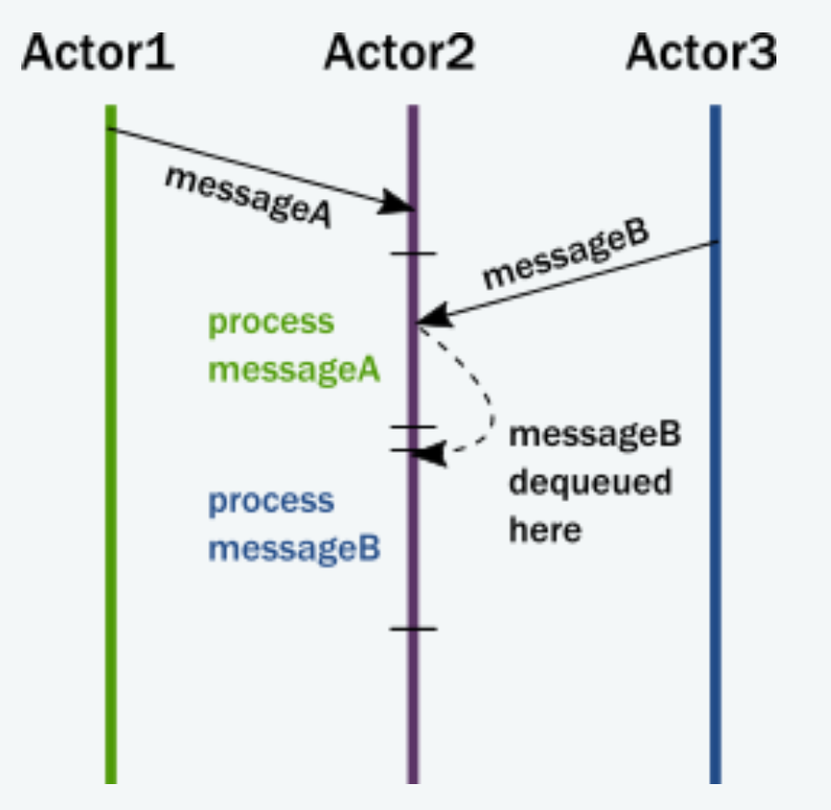
SEND
Asynchronous and Non-blocking - Fire-forget
Everything happens Reactively
An Actor is passive until a message is sent to it, which triggers something within the Actor
EVERYTHING is asynchronous and lockless
Notes:
Messages is the Kinetic Energy in an Actor system
that messages have no return value
With a return value, the sending actor would either need to block
they react to incoming messages sequentially, one at a time
- Actors can have lots of buffered Potential Energy
but can't do anything with it until it is triggered by
a message

Slide 35
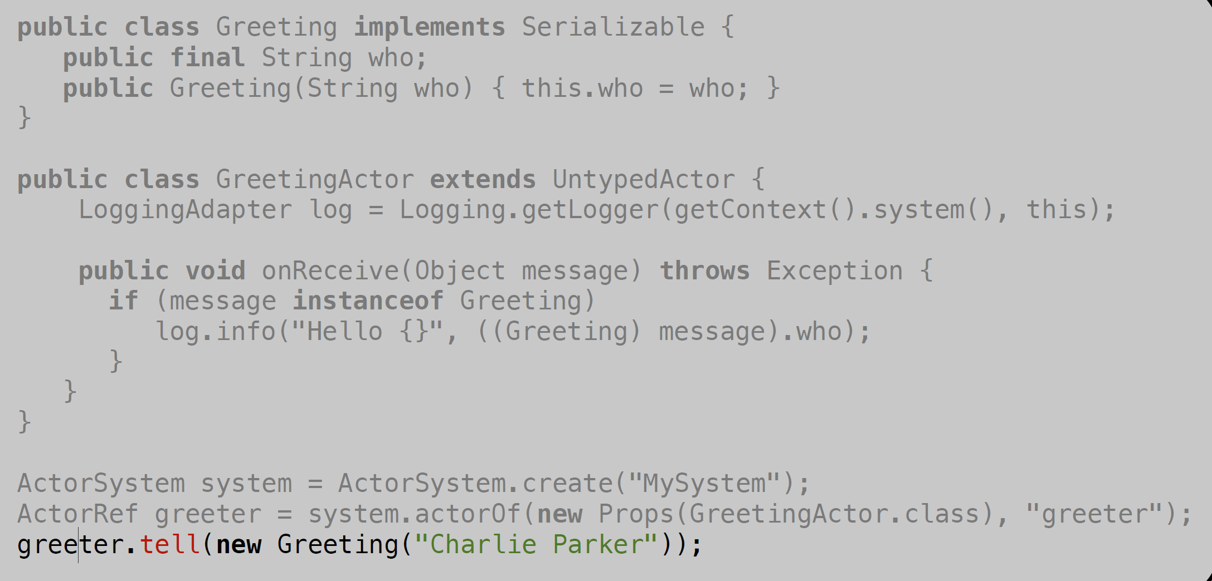

Slide 36
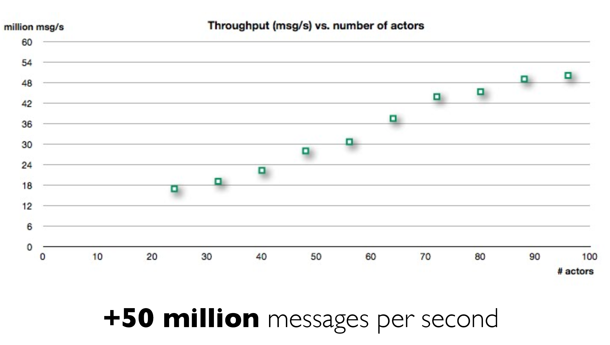
Throughput

Slide 37
BECOME
dynamically redefines Actor’s behavior
Triggered reactively by receive of message
Will now react differently to the messages it receives
Behaviors are stacked & can be pushed and popped

Slide 38
Why BECOME?
Let a highly contended Actor adaptively transform himself into an Actor Pool or a Router
Implement an FSM (Finite State Machine)
Implement graceful degradation
Become whatever the Master currently needs
Notes:
Spawn up (empty) generic Worker processes that
can become whatever the Master currently needs
Load Balancing -> Routers(in practice)

Slide 39
Encapsulating State in Actors
One of the key features of actors is their ability to manage state in a thread-safe manner. This is an important feature to understand, but you also need to be aware that there is more than one way to manage that state

Slide 40
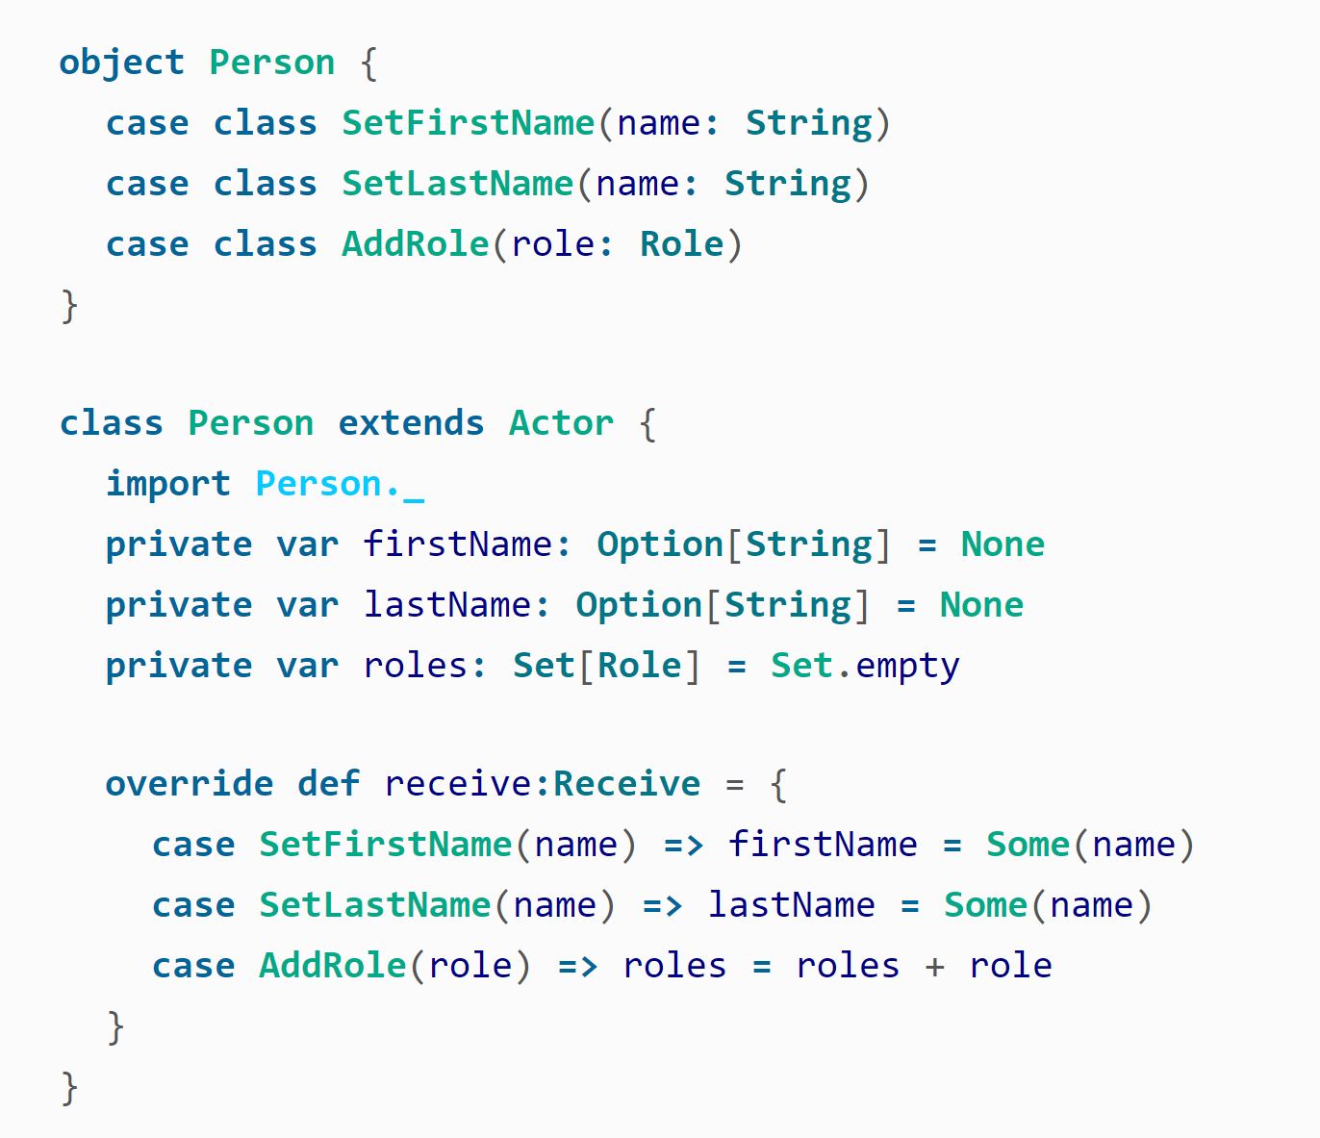
Encapsulating State in Actors (Cont’d)
Encapsulating State by Using Fields
The simplest option for managing state is including the state in mutable private fields inside the actor
Notes:
Encapsulating State by Using Fields
The basic format will be familiar to those accustomed to object-oriented programming and writing getters and setters in languages like Java. If you’re more functional-minded, the presence of mutable state might make you cringe a little, but within the context of an actor, mutable state is safe because it is protected by the Actor Model. If you dig into the standard Scala libraries, you will find that mutable state is actually quite common in what are otherwise pure functions. The mutable state in that case is isolated to within the function and is therefore not shared among different threads. Here, we have isolated the mutable state to within an actor, and due to the single-threaded illusion, that state is protected from concurrent access.
Encapsulating State by Using become
This completely eliminates any need for a var. Now, rather than altering the state by manipulating that var, you are instead altering it by changing the behavior. This changes the behavior so that the next message will have a different Personal Information than the previous one. This is nice because it has a slightly more “functional” feel to it (no more vars), but it also maps better to our understanding of the Actor Model. Remember, in the Actor Model, state and behavior are the same thing. Here, we can see how that is reflected in code.

Slide 41
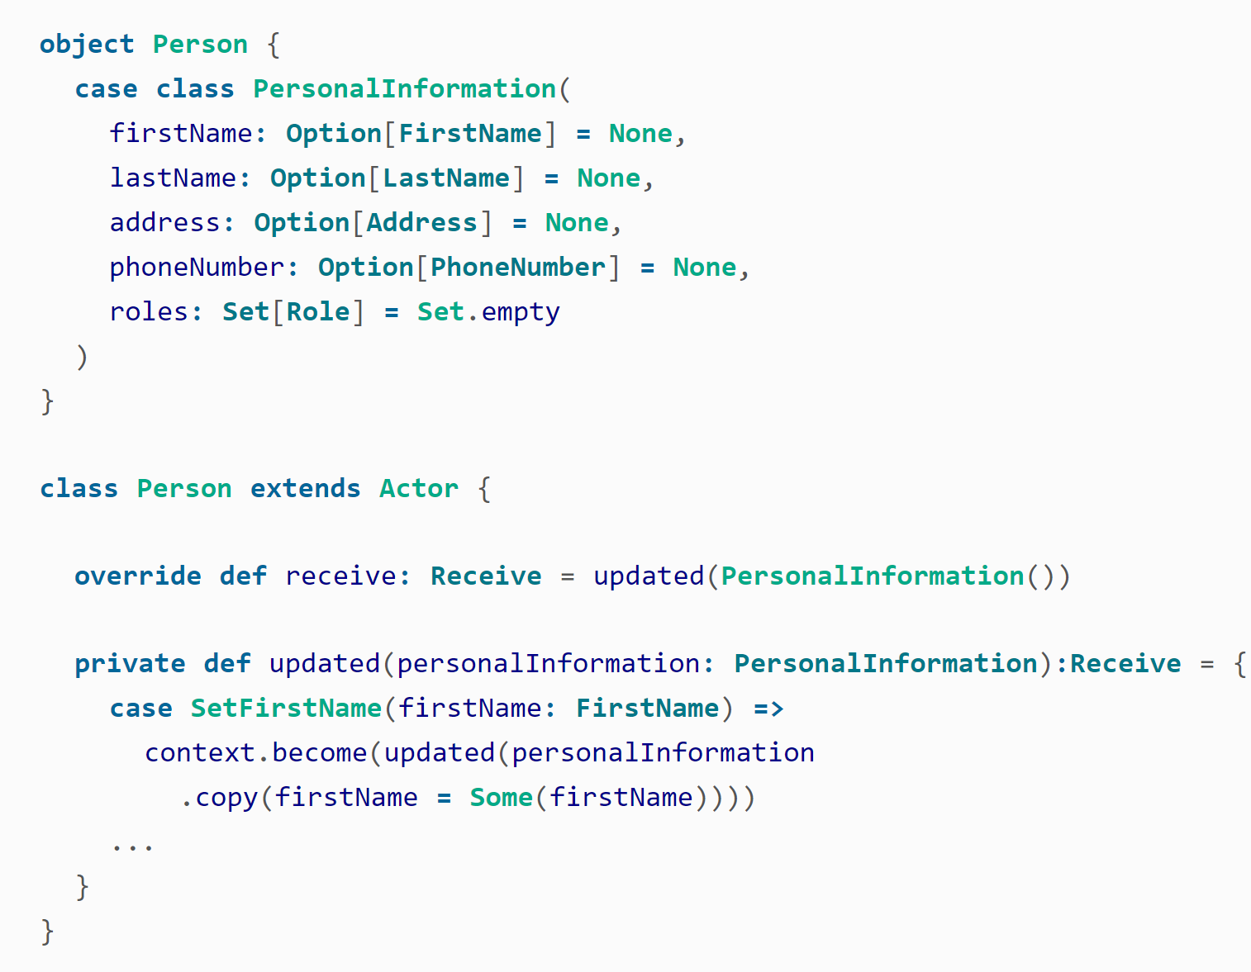
Encapsulating State in Actors (Cont’d)
Encapsulating State by Using become
Another approach to maintaining this state is by using the become feature to store that state. This particular technique also falls more in line with the idea discussed earlier that behavior and state changes are in fact one and the same thing.
Notes:
Encapsulating State by Using Fields
The basic format will be familiar to those accustomed to object-oriented programming and writing getters and setters in languages like Java. If you’re more functional-minded, the presence of mutable state might make you cringe a little, but within the context of an actor, mutable state is safe because it is protected by the Actor Model. If you dig into the standard Scala libraries, you will find that mutable state is actually quite common in what are otherwise pure functions. The mutable state in that case is isolated to within the function and is therefore not shared among different threads. Here, we have isolated the mutable state to within an actor, and due to the single-threaded illusion, that state is protected from concurrent access.
Encapsulating State by Using become
This completely eliminates any need for a var. Now, rather than altering the state by manipulating that var, you are instead altering it by changing the behavior. This changes the behavior so that the next message will have a different Personal Information than the previous one. This is nice because it has a slightly more “functional” feel to it (no more vars), but it also maps better to our understanding of the Actor Model. Remember, in the Actor Model, state and behavior are the same thing. Here, we can see how that is reflected in code.

Slide 42
Failure management in Java/C/C# etc.
You are given a SINGLE thread of control
If this thread blows up you are screwed
So you need to do all explicit error handling WITHIN this single thread
Notes:
To make things worse - errors do not propagate
between threads so there is NO WAY OF EVEN
FINDING OUT that something have failed
This leads to DEFENSIVE programming with:
• Error handling TANGLED with business logic
• SCATTERED all over the code base

Slide 43
SUPERVISE
Manage another Actor’s failures
Error handling in actors is handle by letting Actors monitor each other for failure
This means that if an Actor crashes, a notification will be sent to his supervisor, who can react upon the failure
Every actor has a default supervisor strategy
Notes:
This provides clean separation of processing and
error handling
SUPERVISE Actor
Every single actor has a
default supervisor strategy.
Which is usually sufficient.
But it can be overridden.
https://doc.akka.io/docs/akka/2.5/general/supervision.html

Slide 44
SUPERVISE(Cont’d)
The supervisor delegates tasks to subordinates and therefore must respond to their failures
When a subordinate detects a failure (i.e. throws an exception), it suspends itself and all its subordinates and sends a message to its supervisor, signaling failure.
Supervisor has a choice of the following four options:
Resume the subordinate, keeping its accumulated internal state
Restart the subordinate, clearing out its accumulated internal state
Stop the subordinate permanently
Escalate the failure, thereby failing itself
Notes:
https://doc.akka.io/docs/akka/2.5/general/supervision.html#what-restarting-means
When presented with an actor which failed while processing a certain message, causes for the failure fall into three categories:
Systematic (i.e. programming) error for the specific message received
(Transient) failure of some external resource used during processing the message
Corrupt internal state of the actor

Slide 45
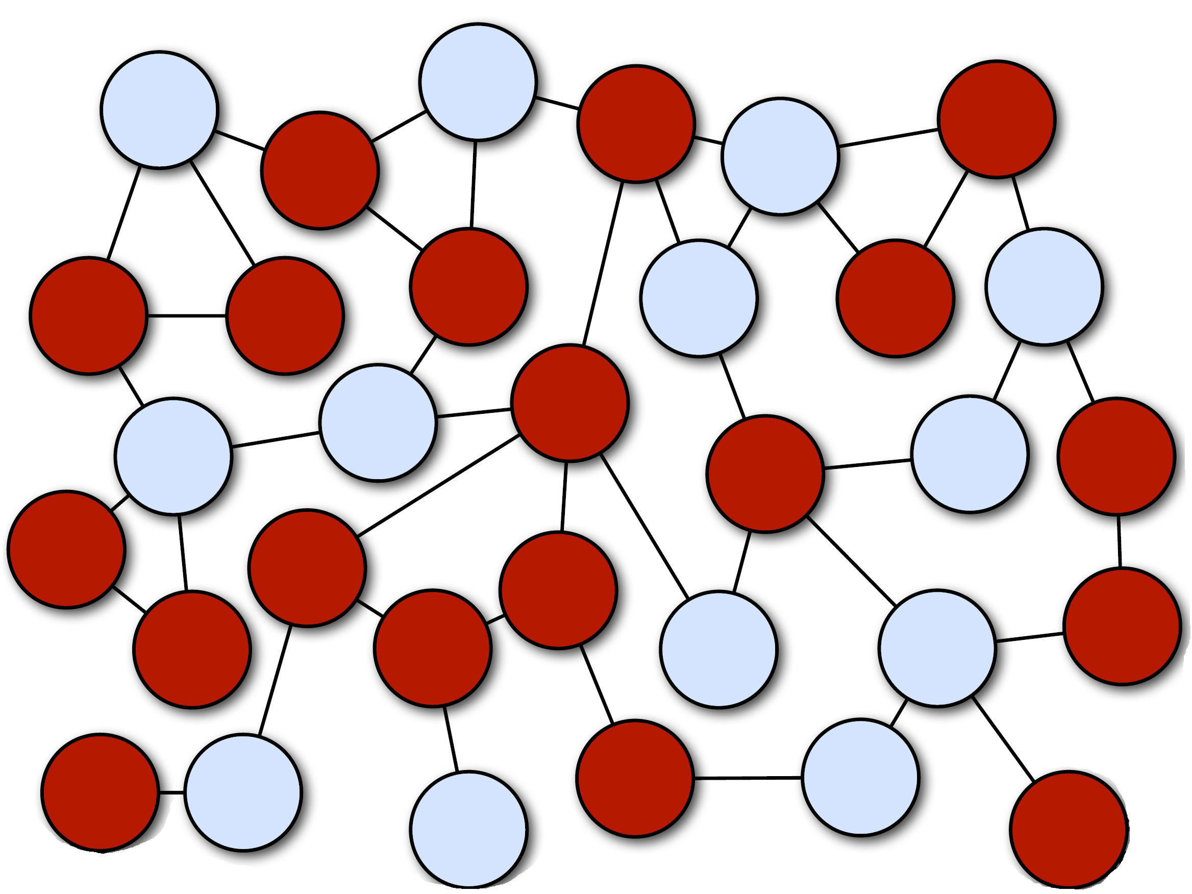
standard OO

Slide 46
Fault-tolerant onion-layered Error Kernel
Notes:
“In a supervision hierarchy, keep important application state or functionality near the root while delegating risky operations towards the leaves.”
This pattern builds on the Simple Component pattern and is applicable wherever components with different failure probability and reliability requirements are combined into a larger system or application—some functions of the system must never go down, whereas others are necessarily exposed to failure. Applying the Simple Component pattern will frequently leave you in this position, so it pays to familiarize yourself well with the Error Kernel pattern.
This pattern has been established in Erlang programs for decades and was one of the main inspirations for Jonas Bonér to implement an Actor framework—Akka—on the JVM.
The name Akka was originally conceived as a palindrome of Actor Kernel, referring to this core design pattern.
https://www.reactivedesignpatterns.com/patterns/error-kernel.html

Slide 47
Fault-tolerant onion-layered Error Kernel
Node1
Node2

Slide 48
Akka Cluster
Terms
Node
A logical member of a cluster. (ActorSystem)
There could be multiple nodes on a physical machine. Defined by a hostname:port:uid tuple
Cluster
A set of nodes joined together through the membership service
Leader
A single node in the cluster that acts as the leader. Managing cluster convergence
Notes:
Seed Nodes
Leader
Gossip
The cluster membership used in Akka is based on Amazon’s Dynamo system and particularly the approach taken in Basho’s’ Riak distributed database. Cluster membership is communicated using a Gossip Protocol, where the current state of the cluster is gossiped randomly through the cluster, with preference to members that have not seen the latest version

Slide 49
Akka Cluster
Provides a fault-tolerant, peer-to-peer based cluster membership service
using gossip protocols and an automatic failure detector
Allows for building distributed applications
Notes:
member ship + host port id + if remove cant rejoin until stop and then start because of id
Goosip + seen set
Failure + heart beat + neighbours+

Slide 50
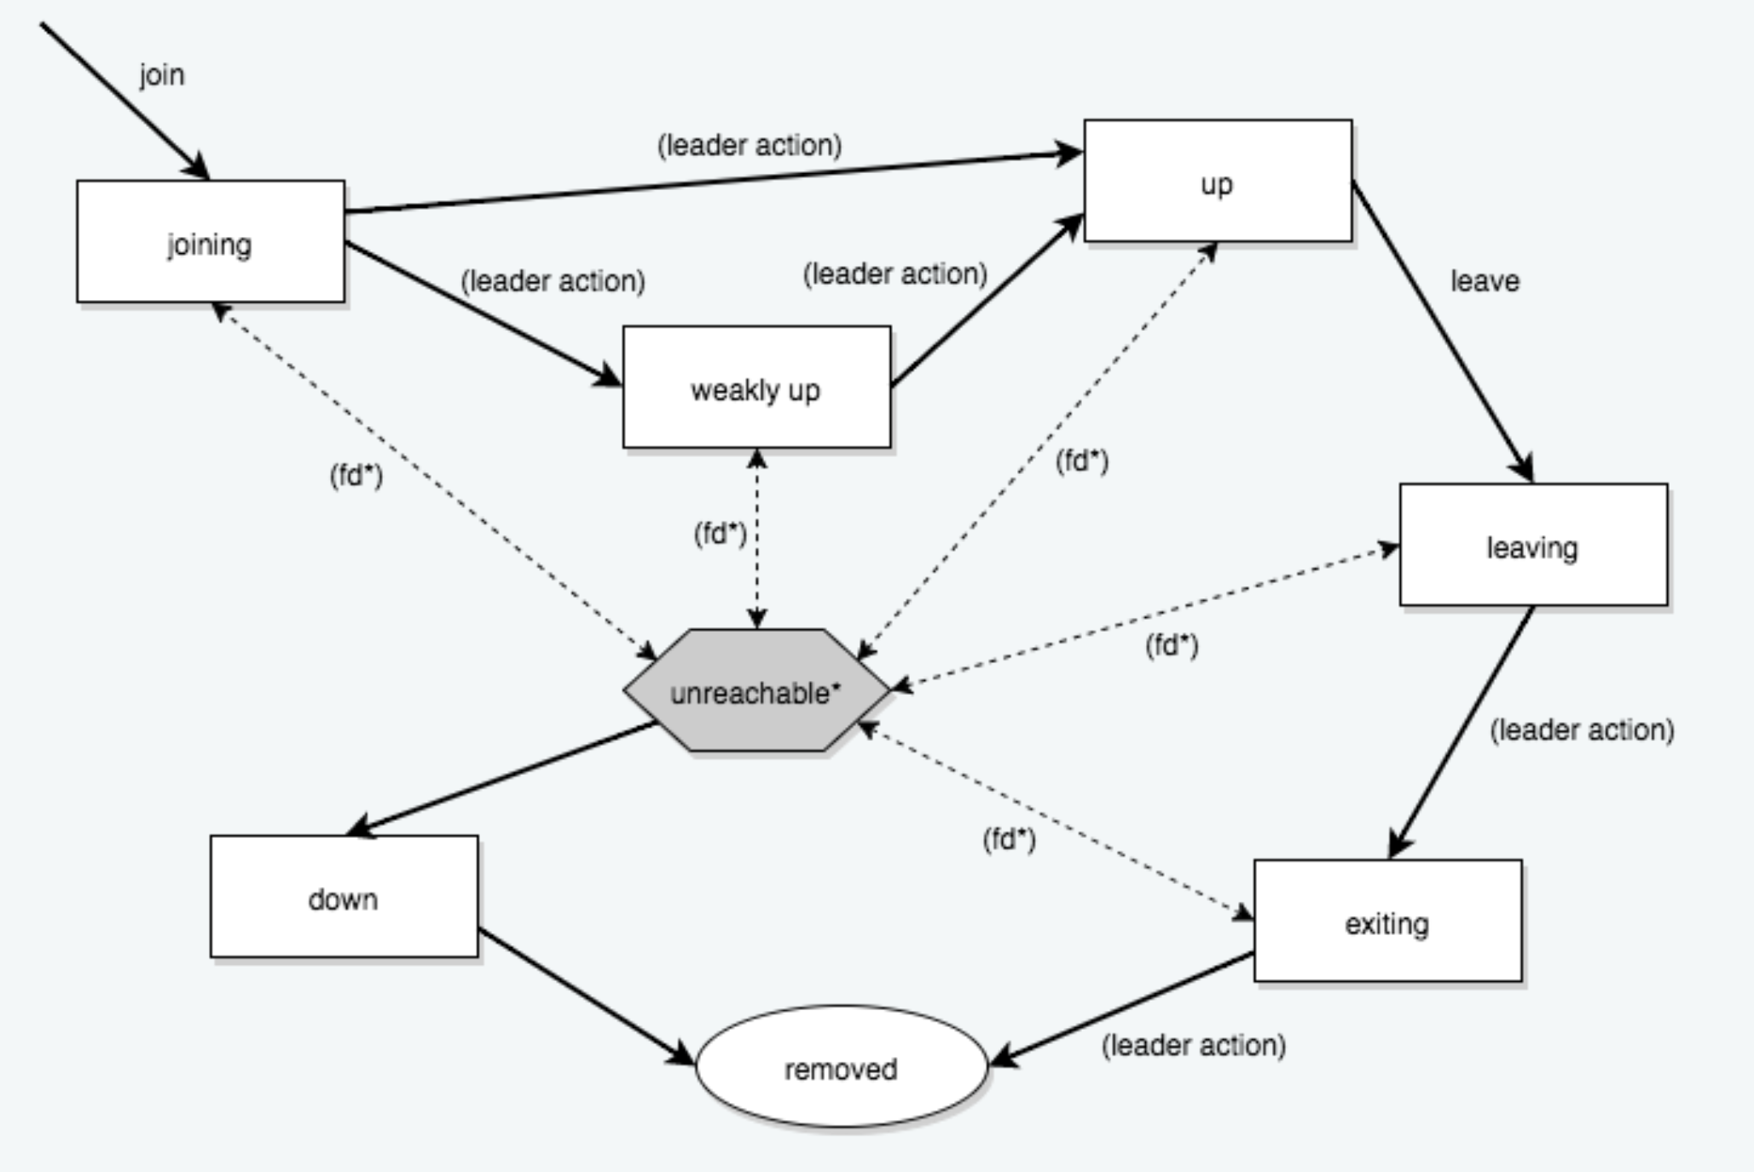
Membership Lifecycle

Slide 51
Cluster Usage
Microservices
Traditional distributed application

Slide 52
“Lightbend”, URL:https://developer.lightbend.com/guides/, Access Date: 12/4/2019.
“Akka Documentation”, URL:https://doc.akka.io/docs/akka/current/, Access Date: 12/4/2019.
“Reactivedesignpatterns”, URL:https://www.reactivedesignpatterns.com/patterns/error-kernel.html, Access Date: 12/4/2019.
“Jonasboner”, URL:http://jonasboner.com/talks/, Access Date: 12/4/2019.
“Slideshare”, URL:https://www.slideshare.net/jboner/introducing-akka, Access Date: 12/4/2019.
“Martinfowler”, URL:https://martinfowler.com/articles/serverless.html#WhatIsServerless, Access Date: 12/4/2019.
“Martinfowler”, URL:https://martinfowler.com/bliki/Serverless.html, Access Date: 12/4/2019.
“Markheath”, URL:https://markheath.net/post/thoughts-on-serverless, Access Date: 12/4/2019.
“ Wikipedia”, URL:https://en.wikipedia.org/wiki/Actor_model, Access Date: 12/4/2019.

